Slide 2
GMail

Slide 3
A fresh and clean look for Gmail on the web, cont’d

Slide 4
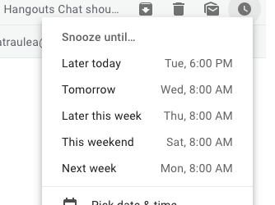
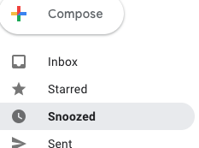
Snooze - Reminder to follow up on important email
Manually postpone emails and temporarily remove them from your inbox. Emails will reappear at the top of your inbox at the given time that is more convenient.
Snoozed items can be found under “Snoozed” in the menu bar.

Slide 5
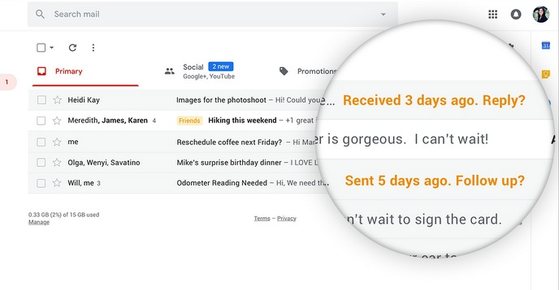
Nudge Feature
When you have a lot of emails, some will inevitably be missed.
To help with that Gmail will now “nudge”you to reply to emails that may have missed and to follow up on emails for which you haven’t responded.
Notes:
Nudging is on by default with the new Gmail enabled, but can be turned off from the Gmail settings menu.

Slide 6
Calendar

Slide 7
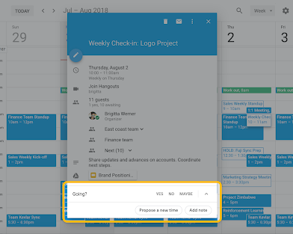
Propose a new meeting time
There is a new feature that enables more efficient meeting scheduling.
Now, each guest invited to a meeting can propose a new time and the organizer can easily review and accept time proposals.

Slide 8
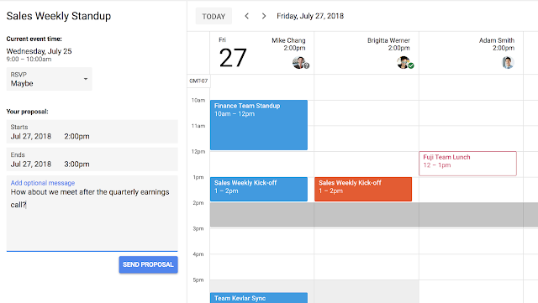
Guests can then send their time proposal along with an optional message to the organizer, who can accept the proposed time with just one click.
Notes:
This functionality works across domains and with Microsoft Exchange. Guests can send proposals to organizers using Exchange, and organizers can receive proposals from guests using Exchange.

Slide 9
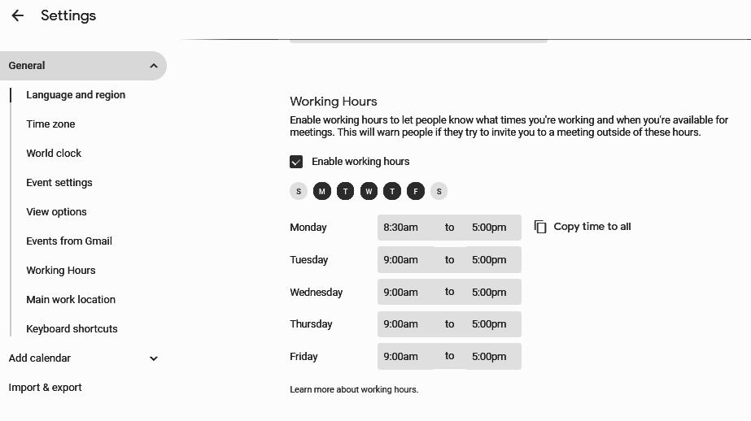
Update Working Hours in Calendar
When you schedule a meeting with other Calendar users, their working hours will be shown in the calendar
If you try to schedule an event outside the working hours of one more or guests, you’ll now see a notification.
Working hours will now be turned on for all users by default. Users can turn it off at any point in Calendar’s settings

Slide 10
Drive

Slide 11
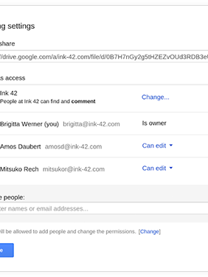
Easy to Share
Save work files or folders in Drive, access them from any device and share them instantly with teammates or customers.
You can even share files with people that don’t use Google Drive. No more sending attachments or spending time merging different versions of files.
Notes:
And I just start talking about how he's easy it is to share with Google Drive and it starts typing your notes for you so you can it's going to keep talking till I turn the mic off

Slide 12
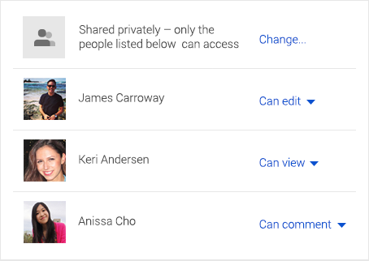
Files in Drive are private, until you decide to share them.
You can quickly invite others to view, comment, and edit any file or folder you choose.

Slide 13
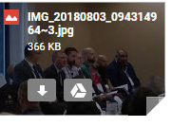
Save Gmail Attachments in Drive
Hover over an attachment in Gmail and look for the Drive logo.
Here, you can save any attachment to your Drive to organize and share them in a single, safe place.

Slide 14
Disable download, print, and copy options in Docs, Sheets, or Slides
Open a Docs, Sheets, or Slides file that you own.
At the top, click Share.
In the bottom-right corner, click Advanced.
Check the Disable options to download, print, and copy for commenters and viewers box.
Click Save changes.
Click Done.
Now, anyone with “view” or “comment” access will see the download, print, and copy options grayed out.

Slide 15
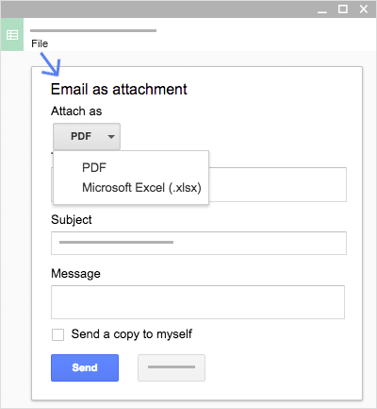
Email a copy as an attachment
If you need to collaborate with someone on your spreadsheet in your old program or format, such as PDF or Excel, you can email it as an attachment.
Click File > Email as attachment.
Select a format.
Enter the email addresses or Groups you want to send copies to.
(Optional) Enter a message.
Click Send.
Note: This sends a copy of the spreadsheet instead of sharing the original, so you won’t be able to use Sheets’ collaboration tools.

Slide 16
Suggesting
Comments
Tag People in Comments
Voice typing
Notes:
The Suggesting mode in Google Docs comes in handy when you only want to suggest changes to the document without actually making any. Once you enable the feature anything you add delete or change in the document will show up as colored marks accompanied by details on the right-hand side such as the name of the suggestor.
The Comments Feature - Allows you to ask questions or make notes to the highlighted sentence or paragraph. People can reply to the comments and carryon a conversation.
If you want to get a specific person’s attention, tag them in the comment. Add an @ or a + sign, then their email address.

Slide 17
TEAM DRIVE
What can you do with Team Drives?
Google Team Drives are shared spaces where teams can easily store, search, and access files anywhere, from any device.
Add Files and Folders, Organize Files and Share and Collaborate
Files in Team Drive belong to the team instead of an individual.
Notes:
Unlike files in My Drive: Files in the Team Drive belong the Team, not an individual. When employees leave, the files remain. Much easier to manage for Managers and IT staff.And it's going to start recording everything that I say and my slide notes okay

Slide 18
CREATE A TEAM DRIVE
Open Drive.
In the left navigation, click Team Drives.
At top, click New.
Enter a name.
Click Create.

Slide 19
Forms
Notes:
And you just start talking and it will start adding whatever you want into the slide notes. So very nice Going to click on the microphone and you'll see it starts typing okay

Slide 20
Let’s Create a Form

Slide 21
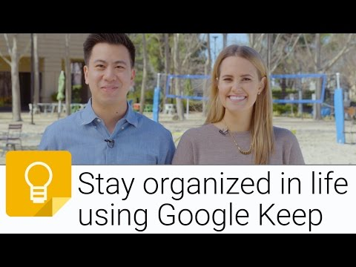
Using Google Keep
Just go to:
keep.google.com

Slide 22
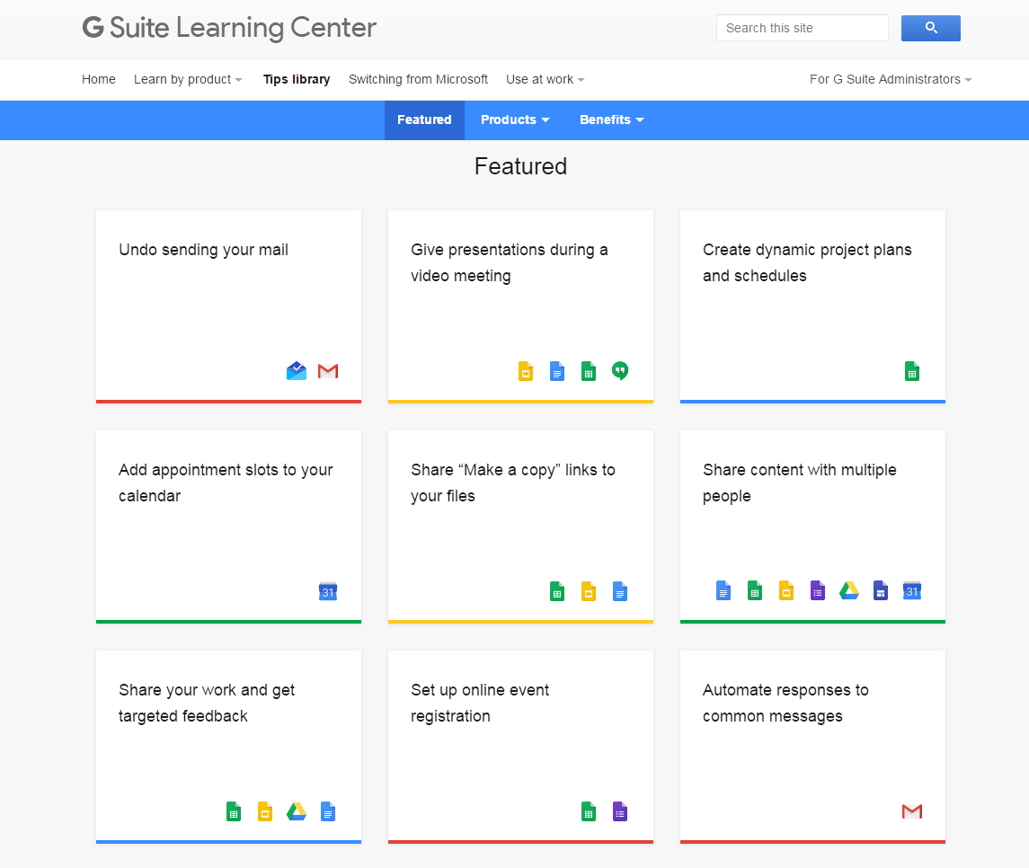
Google Tips Library
https://gsuite.google.com/learning-center/tips/

Slide 24
¿¿¿Questions???

